Slide 1



Slide 2

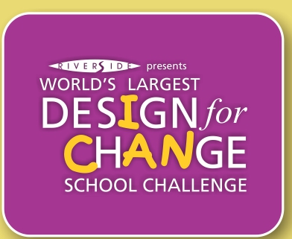
What Are Your
Super Powers?
Notes:
Super Powers is a warm up ice breaker activity to get students to start thinking about the important issues which affect their life and their community.
Start by asking students an open ended question, e.g., think about something you are good at- something you do well that makes you proud or that others tell you that you do well. If you could turn that into a superpower that could change our world, what would that superpower be? How would it change our world or make it a better place?

Slide 3
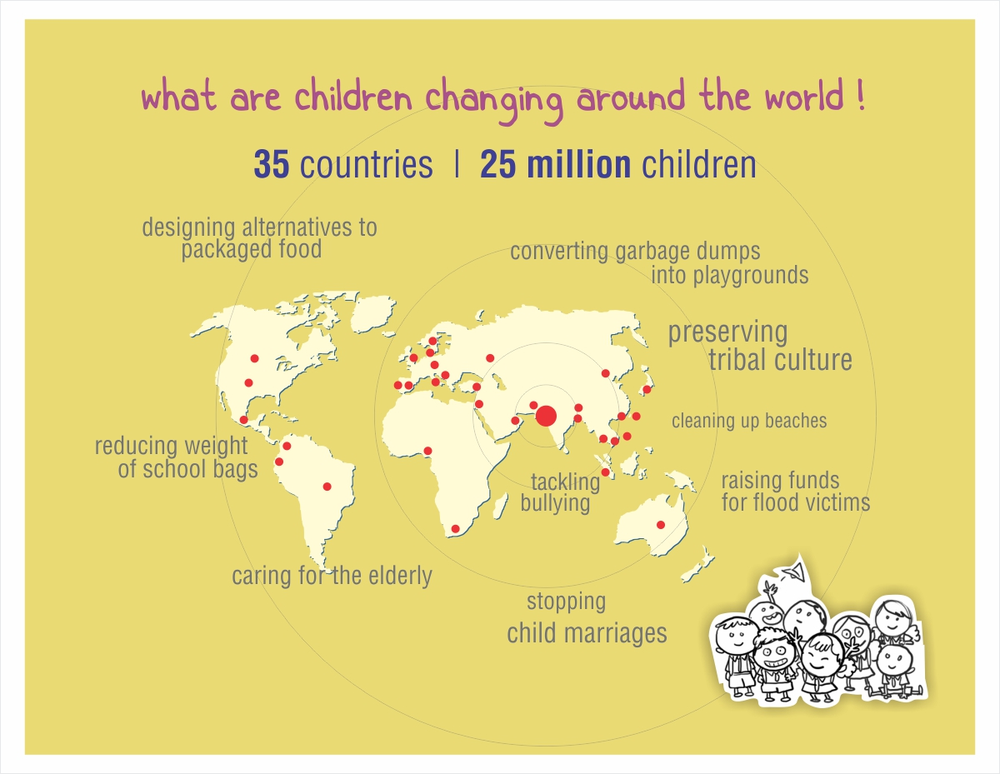
Notes:
Design for change has worked with students and students in over 35 countries. All the projects are student-led and address issues in the student’s local communities.

Slide 4
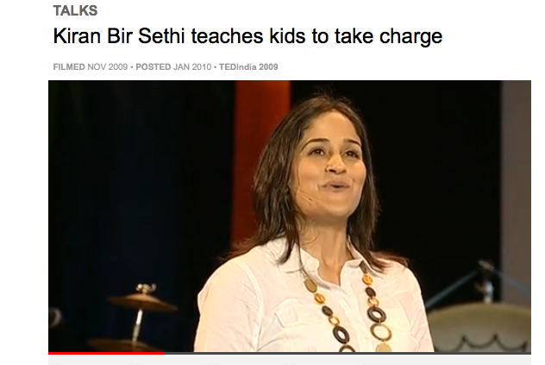

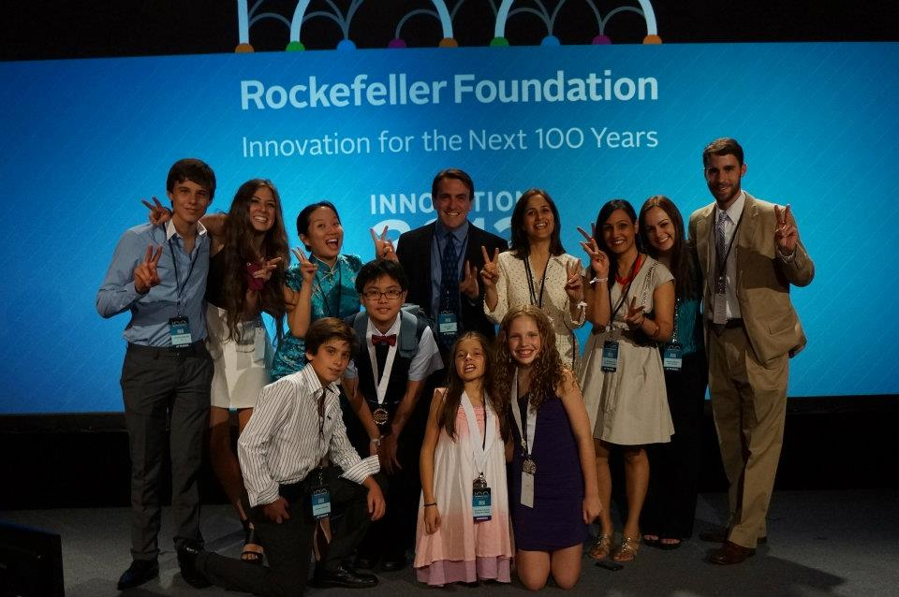
Who Are We?
Kiran Sethi, Founder of Design for Change at TED
DFC wins Rockefeller Young Innovator Award
Notes:
Design for Change USA is part of a global movement that began in 2006 with the vision of Kiran Sethi. It started at the Riverside School in India, and since then, Design for Change has turned into a global initiative involving students from around the world. Design for Change USA launched 2 years ago, with the goal of helping students believe in themselves and their power to change the world.
Here are some of the projects students have done in the US to improve their communities.

Slide 5

Kids on The Move
Creating Bike Paths- Students at G Ross Elementary School felt that childhood obesity was a problem and advocated for safe bike trails for their community.
ADDvertising: Positive Message for Positive Change
Plagued by negative advertising, fifth graders from Pearl River Middle School in New York decided to spread messages of positive change through a campaign called "Add"vertise.
Notes:
Here are some of the projects students have done in the US to improve their communities.

Slide 6
Design Thinking Framework
FEEL
( What is bothering us?)
IMAGINE
( Let’s brainstorm what we can do about it!)
DO
( What is our plan? Let’s do it!)
SHARE
( Let’s inspire others!)

Slide 7
Other children who used
to make a change.
Redona, Brazil
Australia
Tapei, Taiwan
Project Transformation
4RV
Your existence is not only sound to me
Notes:
Examples of how children used the design stages of Feel, Imagine, Do and Share to make a change.

Slide 8


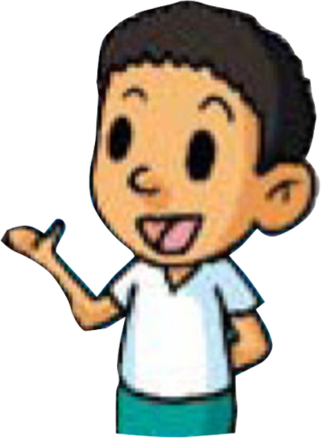
We will need to identify what we know and decide what is bothering us in our community.
“Think from your Heart”
Sensitize, Identify, Engage
Who is affected?
Who and/or what is part of the problem?
Why is it the way it is?
Notes:
Step1: Feel – Introduce students to the types of questions they will need to consider in the Feel stage.
When it’s time to implement, the Feel stage may look like this:
Ask students to divide up into groups of 3-5 and provide post-it notes, markers, and chart paper to each group. Ask each group to consider some of the challenges they see in their community- things in their life or observation that bother them. For example, bullying, health, negative influence of media, discrimination, etc.
Ask each group member to come up with their own issues and write them down on individual post-it notes. Students should have about 3-5 minutes to come up with all the issues they can think of.
After students are done writing their concerns, ask each group member to present their thoughts to the rest of their group by explaining the issue and sticking their post- it notes on the chart paper. Ask the group to categorize the sticky notes so that similar topics are organized together.
The groups discuss the issues that came up. Are their common concerns amongst group members? Why do these concerns exist?
After talking about the issues that exist, students should decide which challenge they would like to solve. The group can decide based on consensus or take a vote to see which issue is the most popular.

Slide 9
BRAINSTORM: Identify challenges, or problems we see, that bothers us. PRESENT: Share concerns with group members. DISCUSS: What are the common concerns? Why do they exist?Who are the people involved? VOTE: Determine which challenge we agree to address.

Slide 10
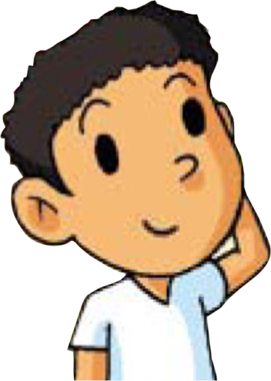

Brainstorm Ideas
We will need to identify possible solutions or what steps we can take to change it for the better.
Which idea has the most impact on the most people?
Do we have or can we acquire the resources to get it done?
Which idea has the most long lasting potential?
Notes:
Step 2: Imagine – Introduce students to the types of questions they will need to consider in the Imagine stage.
When it’s time to implement, the Imagine stage may look like this:
Now that the issue has been identified, it’s time to imagine ways to address this challenge. Ask students to individually brainstorm ways they think the issue should be addressed. These ideas don’t need to be completely realistic. Out-of-the box thinking can help bring out creative solutions, so feel free to dream big!
After students have come up with their own ideas it’s time to discuss as a group. Ask students to share their ideas with each other, if the group thinks up new ideas during this process add them to the list! Ask each student to explain their ideas and stick the post-it notes on a new sheet of chart-paper. After all the ideas have been presented, what new suggestions come up?
Ask students to come up with their own criteria to determine which solution they would want to implement. Do they want to implement a plan with the most impact? The least time-consuming? The most creative?
The group can decide based on consensus or take a vote to see which solution they would like to implement.

Slide 11
BRAINSTORM: Individually, identify solutions to the issue. All ideas are valuable. Think bold and think creatively.
PRESENT: Share ideas with group members. DISCUSS: What are some of the most creative ideas? Which will have the most impact? Which will create long lasting change?
VOTE: Determine which change idea we agree to implement.

Slide 12


“Yes I Can!”
We will need to organize ourselves, devise a plan of action and do it.
How long will it take?
What tasks are needed and who will do them?
What resources will we need to acquire?
How will we document our work?
Notes:
Step 3: Do– Introduce students to the types of questions they will need to consider in the Do stage.
When it’s time to implement, the Do stage may look like this:
Ask each group to ideate ways in which they can take action – how can they make their imagined solution a reality? Each group should list the action plan on chart paper so it can be posted for everyone to see.
One presenter from each group will be required to present the Action Plan. All other groups will be encouraged to ask questions and challenge the group to think more deeply about their proposed solution.
Finally, all the students should vote on which solution they would want to put into action.

Slide 13
BRAINSTORM: How can the solution be put into action? What resources are needed? How many people are involved? How much time will it take?
CREATE: Write out the action steps on chart paper.
PRESENT: Share the action steps with the group.
VOTE: Determine which plan will get put into action and who will do what.

Slide 14
Do it!

Slide 15

“I Can! Now You Can Too!”
We will need to tell our story.
Who will benefit from hearing our story?
How will we share it with everyone?
Notes:
Step 4: Share– Introduce students to the types of questions they will need to consider in the Share stage.
When it’s time to implement, the Share stage may look like this:
Give students time to discuss or write about what they learned through this process. What did they like about the project? What have they learned? This can be done in small groups or as a big group discussion.

Slide 16
DISCUSS: How can we continue to use the DFC process be in our classroom? SUBMIT: Fill out the feedback form. CELEBRATE: What went right? What will we do differently next time? What makes us proud?

Slide 17
What attributes will we need to be successful?
I Can!!
Notes:
Let students brainstorm the attitudes and skills they will need to demonstrate to be successful.

Slide 18
What attributes will we need to be successful?
Empathy
Collaboration
Listening skills
Speaking skills
Writing skills
Presentation skills
Responsibility
Time Management
Leadership
Problem solving
Critical thinking
Creative thinking
I Can!!
Notes:
Here are some of the attitudes and skills that can be developed through the DFC curriculum.

